Slide 1

Phone Pe Data Analysis
- Aditya Verma
- Data Analyst at Innovexis

Slide 2
Introduction
This project focuses on analyzing PhonePe Pulse data to uncover meaningful insights about digital transactions, user growth, and regional trends across India.
📊 Analyzed 1,00,000+ records covering transactions, users, states, districts, and time periods
🗂️ Data sourced from the PhonePe Pulse GitHub repository and transformed into structured datasets
🧹 Performed data cleaning, preprocessing, and transformation to ensure accuracy and usability
📈 Built an interactive Power BI dashboard with dynamic filters and drill-down capabilities
🌍 Developed geo-visualizations to understand state-wise and district-wise distribution
👉 The dashboard enables users to explore:
Transaction volume & amount trends
User growth patterns
Brand/device distribution
Regional performance insights

Slide 3
Agenda of the Meeting
Introduction providing an overview of the PhonePe data analysis project along with its objectives and scope.
Problem Statement where key challenges in analyzing large-scale transaction data and the need for an interactive visualization solution will be discussed.
Data Overview will cover the dataset source and structure, including the analysis of 1,00,000+ records across transactions, users, states, districts, and time periods.
Data Processing, explaining data extraction, cleaning, transformation, and modeling in Power BI.
Dashboard Walkthrough will demonstrate KPI metrics, geo-visualizations, and dynamic filters such as year, quarter, and region.
Key Insights section will highlight important findings like transaction trends, user growth, and regional performance patterns.
Advanced Analysis, focusing on metrics such as Year-over-Year (YoY) growth and contribution analysis.
Business Impact section, where actionable insights and opportunities for growth will be presented.
Conclusion, summarizing outcomes and learnings, followed by a Q&A session for discussion and clarification.

Slide 4
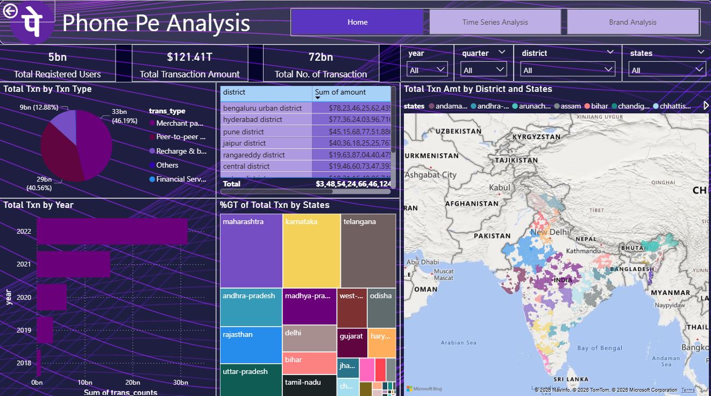
Home Page
This dashboard presents an analysis of over 1,00,000+ PhonePe transaction records, providing a comprehensive view of digital payment trends across India. It highlights a total of 5 billion+ registered users, with an overall transaction value of approximately $121.41 trillion and more than 72 billion transactions recorded. In terms of transaction types, merchant payments dominate with around 46.19% (33 billion transactions), followed by peer-to-peer transactions contributing about 40.56% (29 billion), while the remaining share comes from recharges, financial services, and other categories.

Slide 5
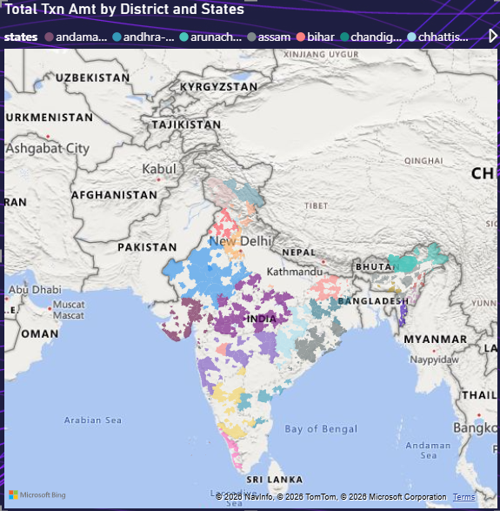
Geographically, the data shows that states like Maharashtra, Karnataka, and Telangana are the top contributors to transaction volume, with major urban districts such as Bengaluru Urban, Hyderabad, and Pune leading in transaction amounts, each contributing in the range of ₹40 crore to ₹78 crore+.
The trend analysis indicates a strong and consistent growth in digital transactions from 2018 to 2022, with a peak observed in 2022 at over 30 billion transactions, reflecting rapid adoption of digital payments. Overall, the dashboard demonstrates a high concentration of activity in urban regions along with significant year-on-year growth, highlighting both the maturity of key markets and the potential for expansion in emerging areas.

Slide 6
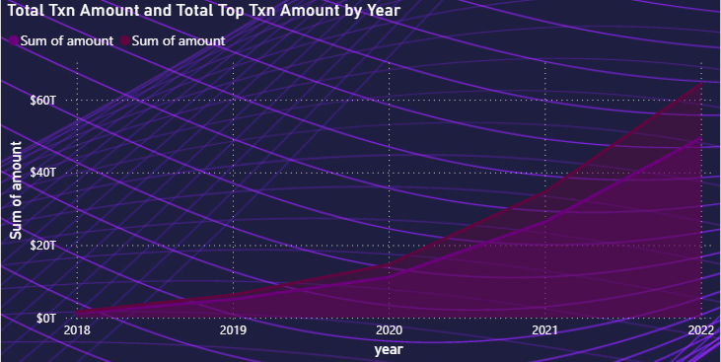
Time Series Analysis
Both metrics show exponential growth, rising from ~$2–3T in 2018 to ~$45T (total) and ~$65T (top transactions) in 2022.
The Top Transaction Amount consistently exceeds Total Transaction Amount, with the gap widening significantly over time.
From 2020 to 2022, total transactions grew from ~$12T to ~$45T (~275% increase), while top transactions surged from ~$15T to ~$65T (~330% increase) — indicating faster growth in high-value transactions.
The gap between the two increased from ~$2–3T in 2018 to ~$20T+ by 2022, showing a strong concentration of value in top transactions.
The most rapid growth phase occurs between 2020–2022, where both metrics more than tripled, signaling a major acceleration in digital payment adoption and high-value usage.

Slide 7
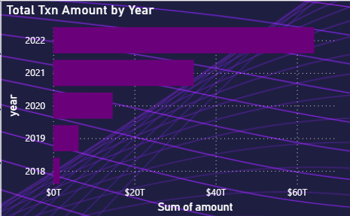
The platform has processed a total transaction value of ~$121.41T, out of which ~$93.25T (~77%) comes from top transactions, indicating a high concentration of value in large transactions.
Total transaction volume is massive, with ~57–72 billion transactions, showing high user activity alongside high-value transactions.
Year-wise Growth:
2018: ~$2T (initial stage)
2019: ~$6–7T (~3x growth YoY)
2020: ~$15T (~2.5x growth)
2021: ~$35–40T (~2.5x growth)
2022: ~$65T+ (~70–80% growth)
From 2018 to 2022, transaction value grew over 30x, highlighting explosive adoption and scale-up.
The biggest acceleration happened post-2020, where transactions jumped from ~$15T to ~$65T (4x increase in just 2 years).

Slide 8
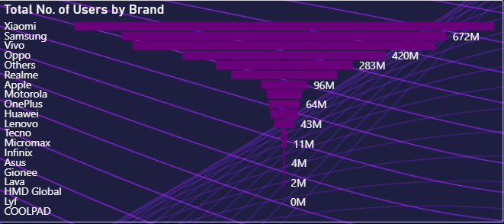
Mobile Brand Analysis
Xiaomi leads by a significant margin, followed by Samsung (~672M users), making these two brands the primary market leaders.
The next tier includes Vivo (~420M) and Oppo (~283M), indicating a noticeable drop of nearly 37% from Samsung to Vivo and another ~33% drop to Oppo.
Mid-tier brands like Realme (~96M) and Apple (~64M) show a sharp decline, with Apple having ~90% fewer users than Samsung, highlighting its relatively niche positioning in terms of user volume.
Beyond the top 6–7 brands, the user base drops drastically: brands like Lenovo (~43M), Micromax (~11M), and Infinix (~4M) have less than 10% of the leading brand’s users.
The bottom segment (Lava, Lyf, COOLPAD) contributes negligible user share (~0–2M), indicating near insignificance in overall market penetration.

Slide 9
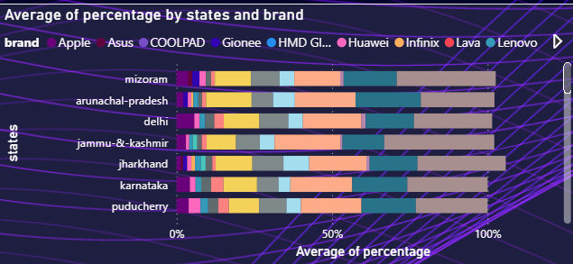
Across all states, the market share is highly fragmented, with no single brand consistently dominating beyond ~20–25% in any state.
Lenovo, Huawei, and Infinix appear to contribute the largest combined shares, often making up ~40–60% of the total in states like Jharkhand, Karnataka, and Puducherry.
Premium brands like Apple and Asus have minimal penetration (~2–8%) across most states, indicating a limited but consistent niche presence.
States such as Jharkhand and Mizoram show a more balanced distribution, where the top 3–4 brands together contribute ~70–80%, suggesting moderate competition.
In contrast, Delhi and Arunachal Pradesh show higher concentration, where a few brands dominate a larger chunk (~60%+ share), indicating less even distribution.

Slide 10
Key Takeaways
Massive Scale of Platform The platform operates at an extremely large scale, processing over $121.41 trillion in transaction value, with more than 72 billion transactions and 5 billion+ registered users. This indicates widespread adoption and positions the platform as one of the largest digital payment ecosystems, handling both high volume and high frequency transactions efficiently.
Dominance of High-Value Transactions A significant ~77% of the total transaction value (~$93.25T) comes from top transactions, highlighting that the platform’s value is heavily concentrated in high-value transactions. This suggests that while many transactions occur, larger transactions contribute disproportionately to total value, indicating strong usage among high-spending users or businesses.
Exponential Growth Trend The platform has witnessed explosive growth of over 30x from 2018 to 2022, with transaction value increasing from ~$2T to ~$65T+. The most significant growth occurred between 2020 and 2022 (4x increase), reflecting rapid digital adoption, likely driven by increased smartphone usage and a shift toward cashless payments.
Urban-Centric Transaction Distribution Transaction activity is highly concentrated in urban regions, with states like Maharashtra, Karnataka, and Telangana leading in volume. Key districts such as Bengaluru, Hyderabad, and Pune contribute the highest transaction amounts, indicating that metro and tier-1 cities are the primary drivers of digital payment growth.
Transaction Type Distribution Merchant payments account for ~46% (33B transactions), followed by peer-to-peer transactions at ~40% (29B transactions). This shows that the platform is not only used for personal transfers but is also widely adopted for commercial and business transactions, making it a dual-purpose ecosystem.
Device Market Concentration The user base is heavily concentrated among a few smartphone brands, with Xiaomi, Samsung, Vivo, and Oppo dominating the majority share. In contrast, smaller brands contribute less than 10%, indicating a top-heavy device ecosystem, which could influence app performance optimization and targeting strategies.
Fragmented State-Level Brand Competition Despite dominance at the national level, brand distribution across states is highly fragmented, with no single brand consistently exceeding 20–25% market share. This reflects healthy competition and diverse consumer preferences across regions, suggesting opportunities for targeted regional strategies.

Slide 11
Conclusion
The platform processed ~$121.41T total transaction value, with ~$93.25T (~77%) coming from top transactions, showing a high-value concentration ecosystem.
Total transaction volume reached ~72 billion transactions, supported by ~5 billion+ users, indicating massive scale and adoption.
Transaction value grew from ~$2T in 2018 to ~$65T+ in 2022 (30x growth), with the fastest acceleration between 2020–2022 (4x growth).
Top transactions are growing faster than overall transactions (~330% vs ~275%), increasing the value gap from ~$2–3T to ~$20T+, indicating dominance of high-value transactions.
Geographically, Maharashtra, Karnataka, and Telangana contribute the highest transaction volume, with districts like Bengaluru, Hyderabad, and Pune leading individually.
In user distribution, Xiaomi, Samsung, Vivo, and Oppo dominate, while smaller brands contribute <10% share, showing a top-heavy device ecosystem.
Final Insight: The ecosystem is hyper-scaled, highly concentrated, and driven by high-value transactions, with strong dominance of urban regions and top brands, while still showing growth potential in smaller states and lower-tier brands.

Slide 12
Thank You
- Aditya Verma
- Data Analyst at Innovexis

